Slide 1

Global Disaster Response Analysis

Slide 2
Dataset Overview
• The dataset contains 50,000 rows and 12 columns representing global disaster events
• Columns Include :Date , Country , Disaster type , Severity index , Casualities , Economic loss usd , Response time hours, aid amount usd , response efficiency score , recovery days , latitude , longitude
• Data Types are 3 Categorical and 9 Numerical Columns

Slide 3
Simple Description of each Column
Date: The date on which the disaster event was recorded.
Country: The country where the disaster occurred.
Disaster Type: The category of disaster, such as earthquake, flood, or cyclone.
Severity Index: A numerical score indicating the intensity or severity of the disaster.
Casualties: The number of people injured or killed due to the disaster.
Economic Loss (USD): The estimated financial loss caused by the disaster in US dollars.
Response Time (Hours): The time taken by emergency services to respond after the disaster occurred.
Aid Amount (USD): The total financial aid provided for disaster relief in US dollars.
Response Efficiency Score: A score representing how effective the disaster response efforts were.
Recovery Days: The number of days required for recovery and restoration after the disaster.
Latitude: The geographical latitude of the disaster location.
Longitude: The geographical longitude of the disaster location.

Slide 4
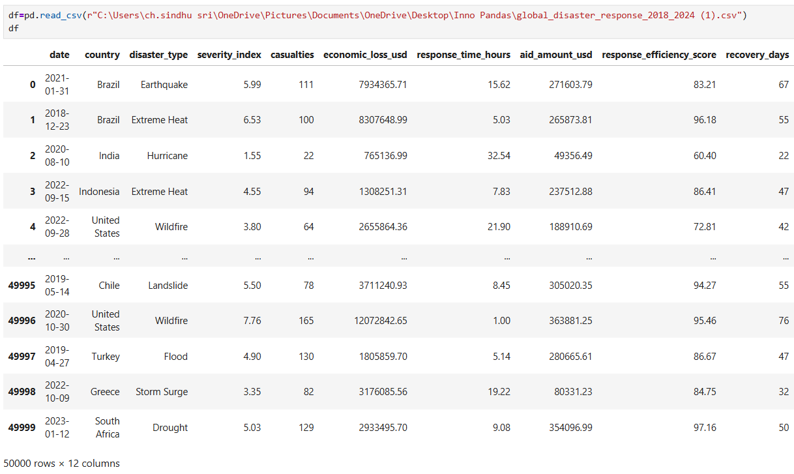
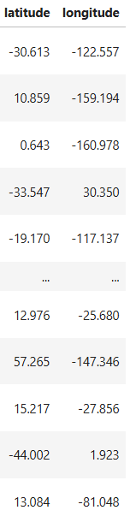
Reading Dataset

Slide 5
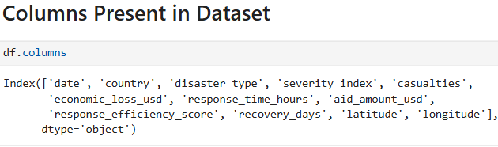
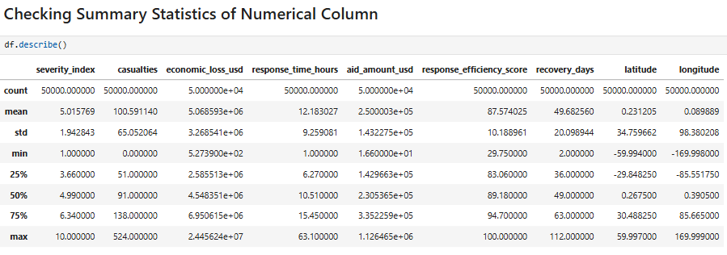
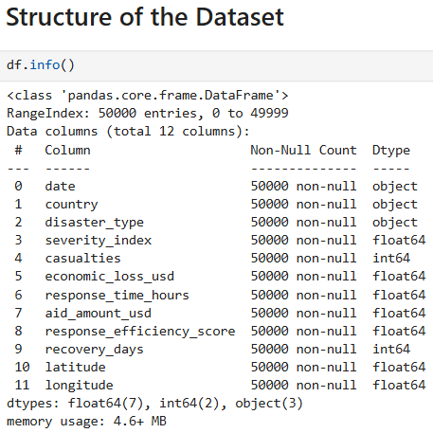
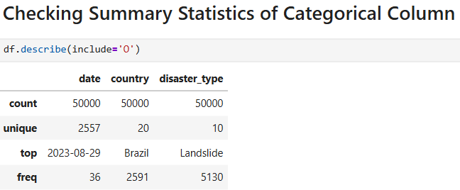
Basic Checks

Slide 6
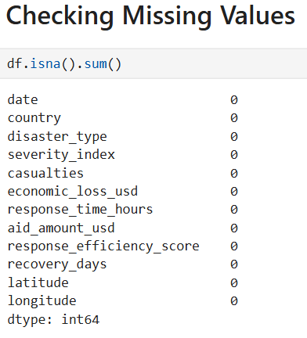
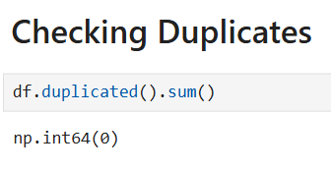
Preprocessing Techniques on Dataset Individual Columns
• Here , you can see We have no Missing Values
• we have no Duplicates

Slide 7
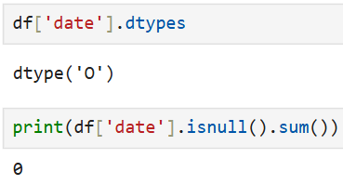
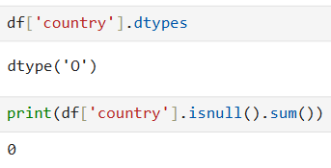
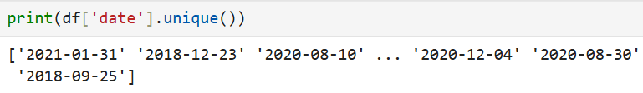
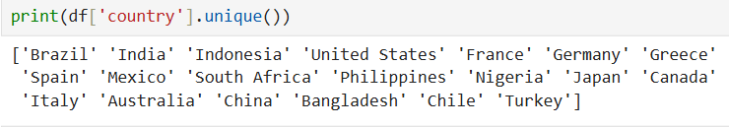
Column : Date
Column : Country
1.Handling Missing Values
1.Handling Missing Values
2. Checking Inconsistences
2. Checking Inconsistences

Slide 8
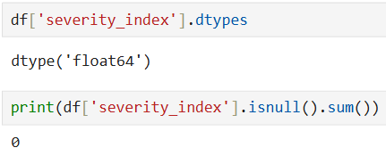
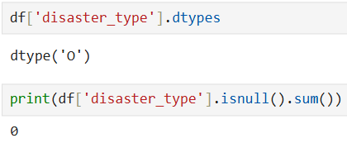
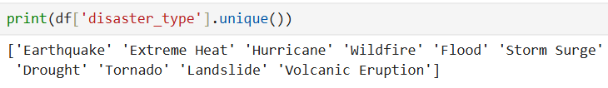
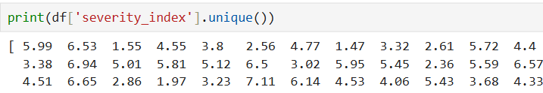
Column : Disaster type
Column : severity index
1.Handling Missing Values
1.Handling Missing Values
2. Checking Inconsistences
2. Checking Inconsistences

Slide 9
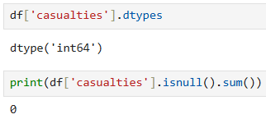
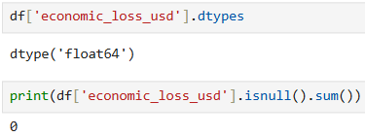
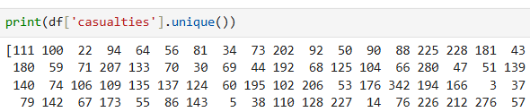

Column : casualties
Column : economic loss usd
1.Handling Missing Values
1.Handling Missing Values
2. Checking Inconsistences
2. Checking Inconsistences

Slide 10
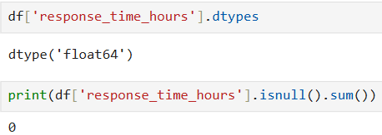
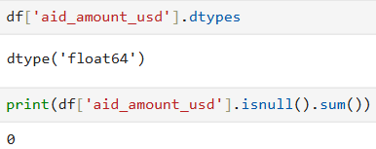


Column : response time hours
Column : aid amount usd
1.Handling Missing Values
1.Handling Missing Values
2. Checking Inconsistences
2. Checking Inconsistences

Slide 11
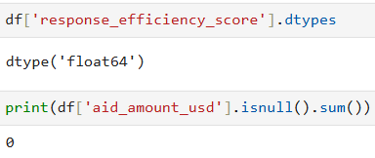
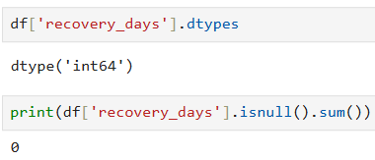

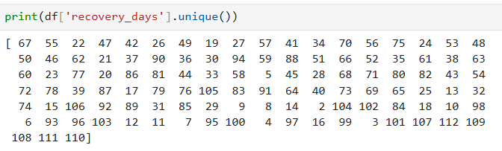
Column : response efficiency score
Column : recovery days
1.Handling Missing Values
1.Handling Missing Values
2. Checking Inconsistences
2. Checking Inconsistences

Slide 12
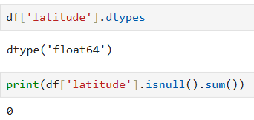
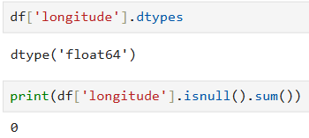


Column : latitude
Column : longitude
1.Handling Missing Values
1.Handling Missing Values
2. Checking Inconsistences
2. Checking Inconsistences

Slide 13
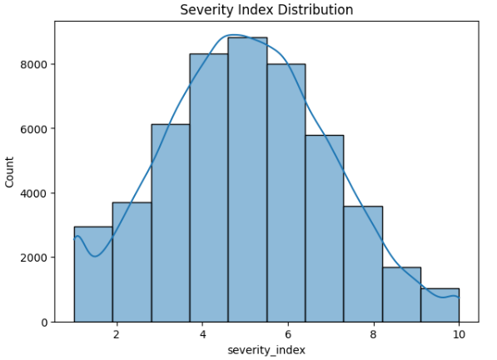
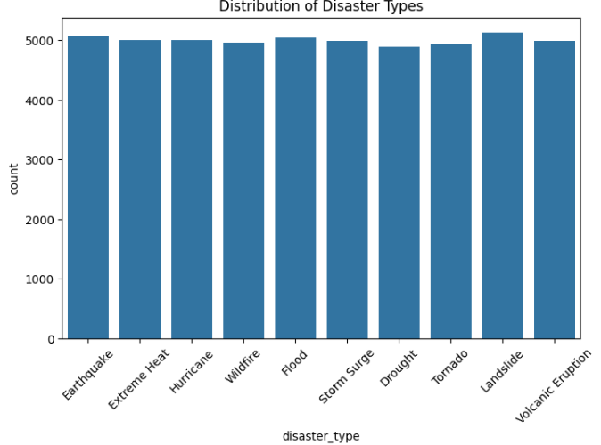
Data Analysis through Visualizations
Univariate Analysis
• The dataset shows an almost uniform distribution of disaster types, indicating balanced data.
• This balanced representation enables unbiased comparison across different disaster categories.
The severity index follows a near-normal distribution, with most disasters having moderate severity levels.
Extremely low and very high severity events are less frequent compared to mid-range values.

Slide 14
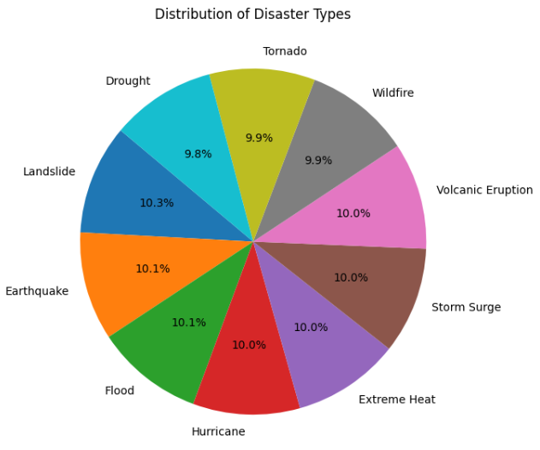
Distribution of Disaster Types
• The pie chart shows an almost equal percentage share for all disaster types, each contributing around 9–10% of total events.
• Landslides, Earthquakes, and Floods have slightly higher proportions compared to other disaster categories.
• Droughts and Tornadoes show marginally lower representation but remain comparable to other disaster types.
• The near-uniform distribution indicates a well-balanced dataset without over-representation of any single disaster type.

Slide 15
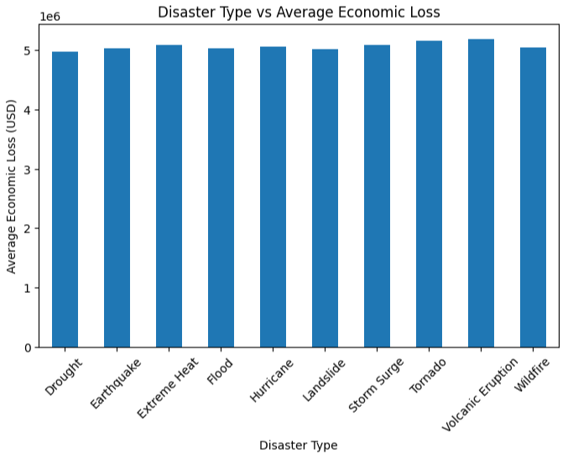
Bivariate Analysis
Categorical vs Numerical
• The chart compares the average economic loss (USD) across different disaster types.
• All disaster types show high and relatively similar average losses, indicating significant financial impact across events.
• Volcanic Eruptions and Tornadoes exhibit slightly higher average economic losses compared to other disaster types.

Slide 16
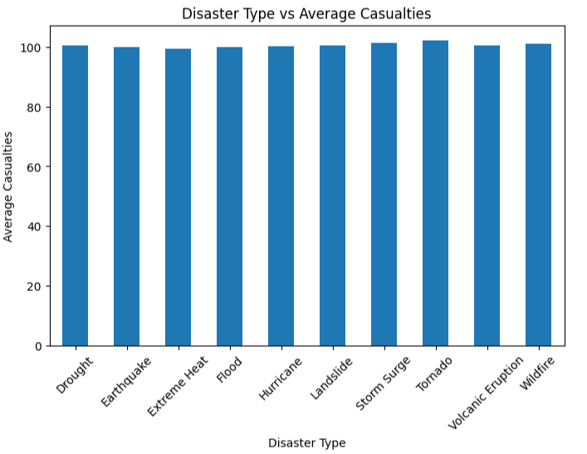
Categorical vs Numerical
The chart illustrates the average number of casualties across different disaster types.
All disaster categories show similar average casualty levels, indicating a consistent human impact across events.
Tornadoes and Storm Surges have slightly higher average casualties compared to other disaster types.
Extreme Heat and Earthquakes show marginally lower average casualties, though differences are minimal.
The results suggest that most disaster types pose comparable risks to human life, reinforcing the need for uniform preparedness and response strategies.

Slide 17
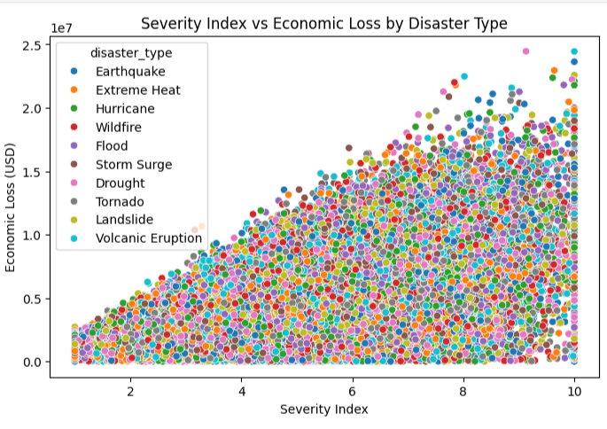
Multivariate Analysis
The plot shows a positive relationship between severity index and economic loss across all disaster types.
As disaster severity increases, the economic loss generally rises, regardless of the disaster category.
Higher severity events (severity index above ~7) are associated with significantly larger financial impacts.
Different disaster types follow a similar upward trend, indicating severity is a key driver of economic loss.
The wide spread of points at higher severity levels suggests variability in impact, influenced by disaster type, location, and response effectiveness.

Slide 18
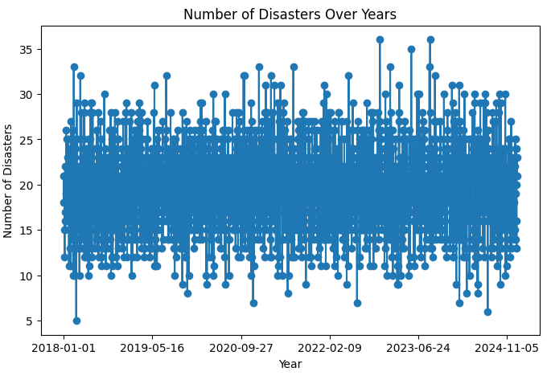
Time Series Analysis
The chart shows year-wise variation in the number of disaster events from 2018 to 2024.
Disaster occurrences fluctuate over time, indicating no single year with consistently low activity.
A slight increasing trend can be observed in the later years, suggesting rising disaster frequency.
Peaks in certain periods highlight years with higher disaster intensity, possibly influenced by climate and environmental factors.
The trend emphasizes the need for continuous preparedness and long-term disaster management planning.

Slide 19
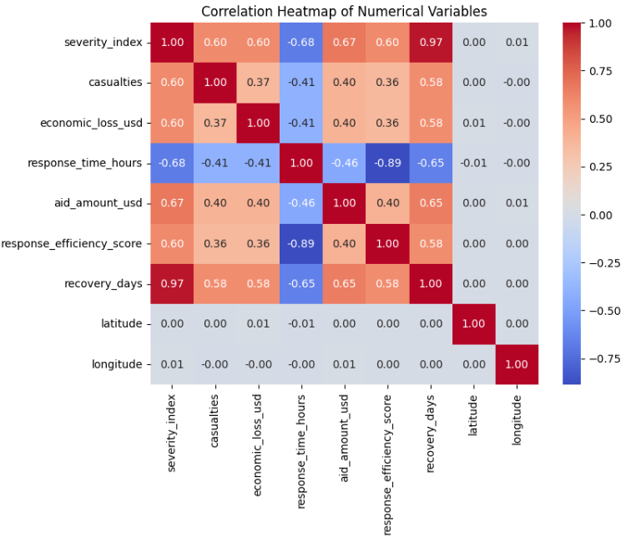
Correlation Heat map
Severity index shows a strong positive correlation with recovery days, indicating that more severe disasters take longer to recover.
Response time has a strong negative correlation with response efficiency score, meaning faster responses lead to higher efficiency.
Casualties and economic loss are moderately positively correlated with disaster severity, showing increased impact with higher severity.
Aid amount has a positive relationship with severity and recovery days, suggesting higher aid allocation for severe disasters.

Slide 20
Summary
• Analyzed global disaster response data from 2018 to 2024 covering multiple countries and disaster types.
• Performed data cleaning and preprocessing to handle inconsistencies and ensure data quality
• Conducted univariate analysis to understand disaster frequency, severity levels, casualties, and economic losses
• Used bivariate analysis to examine relationships between disaster types and key numerical impacts such as severity, recovery time, and economic loss.
• Implemented time-based analysis to identify yearly trends and seasonal patterns in disaster occurrences and impacts.
Conducted correlation analysis to measure relationships between numerical variables and identify strong associations.
Visualized insights using bar charts, scatter plots, heatmaps, and line graphs for better interpretation.

